Slide 1
Thomson Reuters HighQ
Presenter Name
Presenter Title
Notes:
Greetings. My name is XX and I’m here today to discuss law firm productivity and how Thomson Reuters can help you with that.

Slide 2

Today’s Agenda
Market Trends
Law firm processes improved with HighQ
QA/Wrap-up
Notes:
Before we get started, I’d like to share with you where things are sitting in the legal market with some of our Market Research—pulled from our Peer Monitor Index and surveys from Acritas. Then I’d love to hear if this maps to your firms’ situation, and explore, after validation, some ways we at Thomson Reuters could help.

Slide 3




State of the Legal Market
DEMAND
2.0
DEMAND
EXPENSES
TECHNOLOGY
2.0%
1.0
COVID
-6.7%
1.0%
0.0
Remains flat, increasing by 0.4%
6.7% more spent year-over-year
Direct +3.4%
Indirect +1.4%
LEGAL SERVICES
Q1
Q2
0.4
0%
Q1
Q2
Notes:
The beginning of 2020 started out very similar to 2019’s full year performance.
[click]
Demand was somewhat flat, growing at 0.4%. Worked rates climbed to new heights for the second quarter, and expenses remained high, indicating that perhaps firms were still generally comfortable with current market conditions.
And then came COVID. By mid-late March, the world as we knew it began to change. Lawyers went from working in their downtown offices to working 100% from home overnight.
[click]
Mid-Law firms saw the demand for legal services drop by 6.7% compared to Q2 2019.
[click]
[Open the door: Does this resonate? How has your firm managed this disruption? [Listen, and allow this to inform your Why TR conversation downstream.]

Slide 4




State of the Legal Market
CORPORATE COUNSEL
42%
FIRM LEADERS BELIEVE
CORPORATE COUNSEL SAY
24%
VS
Quality & Efficient Work Product
42%
Q1
Q2
Rates are too high
Lack of value
Overall Spend
24%
Demand
Workload
Q1
Q2
Notes:
NOTE – OPTIONAL SLIDE
In Q1 2020, 42% of corporate counsel said they would be increasing their overall spend in the next 12 months, dropping to 24% in Q2.
[click]
Despite this drop in anticipated spend, GCs say they are busier than ever and demand is up.
[click]
The result is a surge in their workload that they need to accommodate, and GCs are often looking to their law firms to help fill the gap for free.
[Open the door: Are you contending with this challenge of doing more with less? If so, what have you done to address it? Again—LISTEN and proceed as appropriate.]

Slide 5

Legal Departments
State of the Legal Market
LEGAL DEPARTMENTS
FIRM LEADERS BELIEVE
CORPORATE COUNSEL SAY
VS
Quality & Efficient Work Product
Labor &
Employment
Spend
Rates are too high
Lack of value
Technology
Spend
Notes:
Although early on in the pandemic, all practice areas besides bankruptcy declined….
[click]
…legal departments have indicated they anticipate their labor & employment spending to increase in the next six months.
When it comes to spending on disputes, it’s a mixed response – with nearly a 1 to 1 ratio saying it’ll increase or decrease.
So what does this mean for law firms? That you need to drastically cut your prices to earn business? That you need to eliminate all expenses in order to sustain the pandemic? The answer is neither of those.
[click]
When GCs were recently surveyed about why they choose one firm over the other--especially now during the pandemic, the answer still comes back to value versus price.
Even further, price is less of a factor to clients when choosing a firm during this pandemic.
What matters now to clients in terms of value is:
Responsiveness
Strong individual players and individuals they have a historical relationship based on trust.
So how can a firm deliver what their clients are looking for while we’re experiencing one of the most disruptive times in our history?
[click]
The answer is technology. As the pandemic progressed, mid-size firms increased their technology spend from 6.7% to 16%. Although seemingly a positive step forward for mid-size firms, a lot of their technology spend was panic-based buying versus a strategic spend.
In order to weather times like these, firms need to change their mindset on technology, changing it from disaster response to disaster preparedness. Firms that do are in a much stronger position to go unphased.
[Tech Discovery Q: How has your firm adopted/invested in technology to weather this pandemic and ensure your teams have what they need to continue to serve clients? If vague, ask on kinds of tech, and how is that working out?]
[Client Demands Discovery: What type of shift have you seen in the demands from your clients during COVID? And how have you been able to pivot to meet those demands?]

Slide 6

State of the Legal Market
SHARE OF WALLET
FIRM LEADERS BELIEVE
CORPORATE COUNSEL SAY
100%
VS
Quality & Efficient Work Product
56%
50%
Rates are too high
Lack of value
32%
14%
0%
Notes:
Depending on their answer to the questions prior, the lead in for this slide could be a little different.
If prospect mentions technology spend, open this slide with something like: “Okay, so it sounds like the technology you have has allowed you to weather the storm. Could it also help you gain a bigger share of your clients’ wallets?”
And if they admit they haven’t had the right technology in place, maybe the lead in is something like
“So you realize that your technology wasn’t sufficient for helping your teams weather the pandemic. If that isn’t enough reason to invest more strategically in technology, there’s another reason you should.”
In a Share of Wallet survey conducted by Acritas:
- they found that the typical firm receives 14% of a client’s external spend.
[click]
- whereas firms that provide clients with an innovative approach increase that share to 32%
[click]
- additionally, firms that have collaborative teams increase that share to 56%!
[If asked]
GCs define a collaborative team is one that
Has a strong leader / point of contact that pre-processes information for the client;
Shares information throughout the firm so that the client isn’t re-educating everyone who works with their company
provide a more holistic approach to handling legal issues from the business perspective –
This is seen in the types of communications, alerts, etc. that the firm shares with the client; can easily and effectively bring in the best resources from the firm to help address issues – even if they arise quickly.
[Tech Discovery Q: How is your firm using technology to show your clients you’re a collaborative firm (in their definition)? Where are you seeing success with it? Where are you seeing gaps?]

Slide 7
State of the Legal Market
CLIENT VALUE
HighQ
Extranets
Easily administrate one to many
Secure sharing
Streamline legal intake
Firm
Automate workflows and processes
Clients
Notes:
So let’s talk about the first the first insight – why GCs choose one firm over another, specifically on value – but their definition of value has changed a little.
[if not reviewed before]
As mentioned, client focus is on
responsiveness
strong individual players
having a historical relationship that they can trust.
[Pause for validation:] Would you agree with this insight? If so, how are you managing client needs on those focus areas? How is that going?
[Status Quo check]
Listen and leverage the talking points below if the prospect mentions pain(think cost/time) around:
client portals
manual workflows/processes
legal document intake and management
administrative management bottlenecks
special, high touch client requests that may have been out of scope in easier days.
[click]
We at have solution called HighQ that can help your firm ensure that you’re providing the type of service your clients are need now.
So how can HighQ help here?
First off, with HighQ you’re able to
easily build firm branded extranets for your clients at scale, delivering a personalized & engaging workspace where you can:
easily and securely share information & documents (with the ability to have an audit trail)
streamline the intake process through online forms, workflow & process automation
provide 24-7 self-service access to expert content that you’re able to manage & publish through HighQ
[Anecdotal case study]
We have firms that regularly use HighQ to provide client extranets. And because it’s so simple to set up, one of our customers literally has a staff of one that supports 200 internal and 900 external users’ use of the sites. Another one of our customers is using HighQ for one of their real estate clients for a due diligence project. Instead of having to remember to send updates twice a week to the client, they provided the client access to the site where she can view real-time status of the project every morning on her iPhone.
[Better way: How does that sound? My guess is that part of HighQ would be a great, no-low-code solution to help move away from the non-billable hours your staff is spending addressing supporting these types of client needs, and focused instead on a blue chip for your firm.
What do you think? What are some areas you’d like to spend more time? [suggest a few based on your research of the firm: I.e., Compliance Management, Transaction Management, etc]
Listen and proceed depending on the response]
[Qualify for Client Engagement/Document Automation/Doc Collaboration/Legal Project Management based on their answers]
[Discovery on Client Management] How about the second insight—Getting Chosen. Did that sound right to you? Are clients asking for one point of contact?
If so, how are you currently managing that? (if no, skip)

Slide 8

State of the Legal Market
CLIENT VALUE
HighQ
Client sites
Easy team permissions
Automated workflows
Legal project management
Client transparency
Firm
Clients
Notes:
Understood—and while there is no technology that can replace that strong point of contact individual in your firm, with HighQ you can:
create client sites to share information easily & securely amongst your team, helping them build up their strengths/knowledge when it comes to your client.
[click]
With its granular permissioning levels, you can feel confident that you’re able to share the right level of information to the right team member.
Additionally, the automated workflow allows you to automate & standardize time-consuming, manual tasks, freeing your team up to focus on more valuable, strategic work for your client.
Internal Collaborative Clarity:
assign tasks to team members
know who has the next step
ensuring you’re all working harmoniously
Lastly, Client Transparency:
provide real-time client access to
spend-versus-budget dashboards
project trackers
status updates
automated alerts
[Discovery on Client Engagement ] What are you currently doing to build up the “strength” of your team to help further develop relationships with clients?
How do you help them to understand the client and its business to help further develop trust in the firm?
[Qualify for Client Engagement/Team Collaboration based on their answers]

Slide 9
State of the Legal Market
SHARE OF WALLET
Process Management
Litigation management
Transaction management
Document collaboration
Workflow management
Innovative
Collaborative
Notes:
So I’ve now shown you ways in which HighQ can help you be the firm chosen by GCs. Let’s talk about increasing your share of their wallet. Does that sound good to you?
[Proceed if validated]
As I mentioned, in a recent Acritas survey*, it was shown that firms that provide an innovative approach increase their share of the wallet by 18%. And firms that show they have a collaborative team increase that share an additional 24% to a total of 56% of wallet share.
[Discovery Process Management: Can I ask how does your staff manage processes currently?
[Listen. How is that working?]
[click]
Let’s talk about innovative approaches to process management. HighQ can aid a firm in innovating a multitude of processes – from Litigation Management, transaction management, document collaboration & more.
[anecdotal client case study 1]
One HighQ customer used it to pitch a portfolio management project to a client. The firm prior to them was only able to review 1 document/hour.
With HighQ this our customer pitched that they could increase that to 3 documents reviewed/hour.
In the end, they actually increased it to 4 docs reviewed/hour.
Net productivity of 400%.
[anecdotal Large Team Collaboration proof point]
They had 20 attorneys working on the project, and by using workflow automation they were able to:
Easily manage & assign tasks
Know the status of the project in real-time
[anecdotal client case study 2]
Another firm has used it to provide a project plan for their client.
Both the firm & the GC have joint responsibilities on the matter, and with the use of workflow they’re able to make sure everyone stays on top of their responsibilities and not lose time.
[Validate: Does that sound like an approach you could see working at your firm? ]
[Qualify: If yes, dig in and qualify for any of the processes above to build a use case stack for the demo]
*The Acritas survey was conducted in Q2 2020, surveying 300 General Counsel and 1200 law firm attorneys.

Slide 10
State of the Legal Market
SHARE OF WALLET
Process Management
Single Solution
Litigation management
Transaction management
Document collaboration
Workflow management
Client sites
Matter management
Legal project management
Innovative
Collaborative
Notes:
Lastly, let’s talk about how to show you have a collaborative team – again, to get to the highest level of wallet share with your clients.
Remember that GCs define a collaborative team
Has a strong leader / point of contact that pre-processes information for the client;
Shares information throughout the firm so that the client isn’t re-educating everyone who works with their company
provide a more holistic approach to handling legal issues from the business perspective –
This is seen in the types of communications, alerts, etc. that the firm shares with the client; can easily and effectively bring in the best resources from the firm to help address issues – even if they arise quickly.
[click]
Because HighQ is a single solution that can be used for filing sharing, document collaboration, workflow automation, task assigning and more
You can easily prove to your clients that you have collaborative teams by creating client sites for your teams
they can easily share information across the matter; assign tasks across the team based on skillset, expertise or bandwidth.
We’ve seen teams use HighQ to track & share executive orders pertaining to COVID, so that everyone has up-to-date information on a fast-moving disruption to business continuity.
We’ve even seen customers share it with every administrative department, to ensure the back-office flows smoothly for clients as well.
[Validate: Do you think your staff could benefit from client sites that leverage document management appropriately to each individual, and defray any client handoff concerns?
If yes, Qualify for Doc Automation, Doc Collaboration, Workflow Automation, Client Engagement, Team Collaboration]

Slide 11

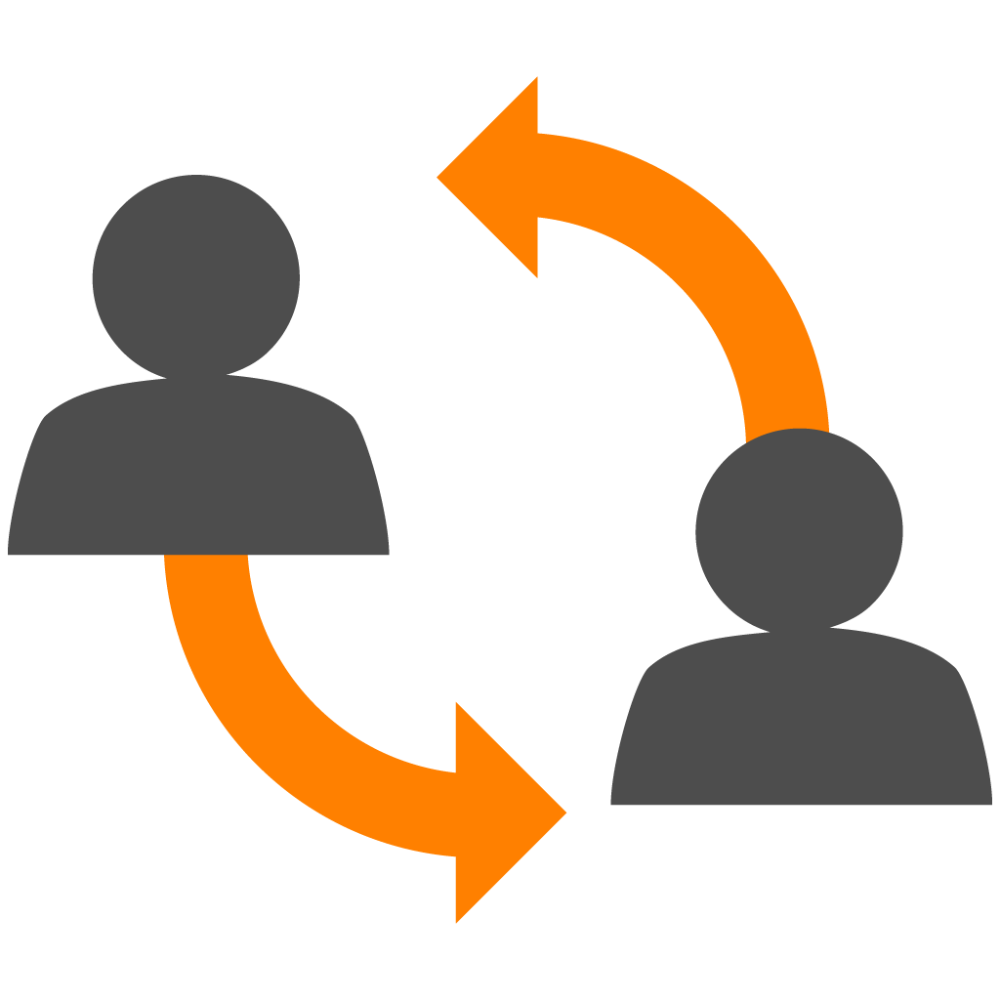








Law Firm Processes
IMPROVED WITH HIGHQ
Client Engagement
Document Collaboration
Legal Project Management
Team Collaboration
Portfolio Management
Litigation Management
Compliance Management
Transaction MANAGEMENT
Improve collaboration and engagement
Increase productivity and efficiency
Streamline project and matter management
Notes:
“So what I heard is [x,y,z] are areas where we could help you. The beauty in HighQ that it provides users with a lot of flexibility, and capabilities all in one solution. It’s extremely common for firms to start using it to address one use case, and as they get more familiar with it, they begin to expand their uses exponentially.
I’m happy to set up a demo where you’ll see these in action and you can ask questions about these processes. What date and times would work for you, and anyone else you feel could benefit?”
At the highest level, HighQ can help you in three ways:
Helps you to collaborate or engage with your clients or internal users. It’s an integrated solution to work with colleagues, collaborate on projects and engage with clients
It’s also about driving productivity & efficiencies by standardizing and automating time-consuming work and processes to help teams become more productive and efficient. Our workflow automation or project management tools to help your teams eliminate a lot of that manual or administrative work that can be so time consuming yet critical to client satisfaction. And, HighQ can help you standardize those processes across the firm.
Lastly, you can streamline matter management, bringing together every facet from project management, data visualization and task management.

Slide 12


Thank You

Slide 13
How HighQ Improves
Law Firm Processes
Use the following slides to articulate how HighQ can address the firm processes your audience has identified as ones they need to improve
Note – only discuss the processes/issues the customer has identified they need to address/improve
Showing how HighQ can address more than the issues the customer has identified will risk confusing and overwhelming the customer, potentially stalling or losing a deal

Slide 14
Appendix

Slide 15
Law Firm Processes
Improved by HighQ
Client Engagement
Document Collaboration
Legal Project Management
Transaction Management
Portfolio Management
Litigation Management
Compliance Management
Team Collaboration
Notes:
HighQ can improve many of the processes law firms have. Looking at this list, which one of these processes are something that your firm has been looking to improve?
What’s involved in these processes, and also what HighQ can address:
Client Engagement - Secure file sharing, pitch portals, knowledge portals, financial reporting, relationship management, tailored content delivery, online products and services
Document Collaboration - Document management, document automation, document analysis, approval workflow, version control, email management and filing, drafting and negotiation
Legal Project Management - Team collaboration, workflow automation, financial dashboards, project status reporting, agile task management, resource management, project planning
Transaction Management - Deal rooms, virtual data rooms, due diligence reviews, contract reviews, closing checklists
Portfolio Management - Real estate management, asset management, fund management, IP and trademark management
Litigation Management - Document bundle organization and sharing, document analysis and data extraction, case research, analysis and status tracking, calendar management, financial reporting
Compliance Management - Horizon scanning, impact assessment, compliance advisory, lobbying and engagement, relationship management, internal education
Team Collaboration - Intranet portals, team workspaces, file share and sync, social collaboration, content management, knowledge sharing, online board rooms, employee engagement
If customer chooses a process/use case, you can go down to the use case section and show how HighQ will address it.

Slide 16
HighQ for
Client Engagement
Differentiate your firm
Build the ultimate extranet for clients, delivering a personalized workspace.
Enhance client value
Offer clients 24-7, self-service access to expert content, systems, and tools.
Provide clarity and visibility
Share a digital interface between you and each client, giving them a transparent, unified picture of exactly where things stand.
Simplify the intake process
Streamline instruction and intake directly through your extranets using online forms, workflow, and process automation.
Deliver an ideal client experience that improves communication and provides value
Notes:
Law Firms want to deliver the ideal client experience but need help creating personalized extranets, portals and microsites that improve the way they collaborate, communicate and provide value-added services to clients.
The issue with most firm’s current state is:
There’s a Lack of tools to manage client engagement and collaboration
Inefficient collaboration internally and externally
Inconsistent submission of legal service requests lack detail
Intake data not collated, tracked or analyzed
Manual allocation of legal requests to staff
Slow response times impacts the law firms’ brand
Poor transparency of status reporting
Experienced lawyers servicing low-value, routine tasks
How familiar does this sound to you?
HighQ can help your firm with client engagement, helping you to:
Differentiate your firm, by building the ultimate extranet for clients, delivering a personalized workspace where you can easily and securely share documents, collaborate on matters, deliver effective legal project management and provide value-added products and services.
Enhance client value by offering clients 24-7, self-service access to expert content, systems and tools that you can quickly create, publish and manage with HighQ - from regulatory guides and comparison toolkits to real-time financial reports and self-service document assembly.
Provide clarity & visibility - Povide a digital interface between you and each client, giving them a transparent, unified picture of exactly where things stand. Matter status, billing details, archived projects, files and contract - they’re all there, securely managed in one single source of truth.
Simplify the intake process - Streamline instruction and intake directly through your extranets using online forms, workflow and process automation - providing consistency of instructions, preventing delays in matter opening and progress, and leveraging the data for dashboards and reporting.

Slide 17
HighQ for
Document Collaboration
Secure file sharing
Securely share large document sets in project workspaces or easily transfer large files using our web, desktop, and mobile apps.
Better project management
Centralize project information and collaboration with agile task management and give your teams the tools to get their work done.
Effective team collaboration
Allow teams to collaborate and communicate efficiently across offices and time zones by reducing the reliance on email.
Enhance external collaboration
Easily collaborate and communicate with users outside of your network by sharing files, work product, and project information.
Collaborate securely on documents and unlock their potential
Greater knowledge sharing
Free information from knowledge silos such as email, network drives, and laptops and share it with others in shared workspaces.
Notes:
Law firms need teams to collaborate securely on documents to unlock their potential, get their work done and be more productive. They also want colleagues and clients to collaborate from anywhere, ideally on any device.
The issue with most firm’s current state is:
Collaboration carried out over email
Documents in silos across devices and systems
Sensitive documents not stored securely
Documents are hard to locate and search
Version conflict due to no central storage
Poor audit trail makes risk management harder
Documents inaccessible remotely
How familiar does this sound to you?
When you use HighQ for document collaboration, you’re able to:
Securely share files
Effectively collaborate on your documents across teams
Provide greater knowledge sharing by no longer living in knowledge silos, having documents stored various ways throughout the firm
Improve your project management
Enhance external collaboration by securely sharing files & project information

Slide 18
HighQ for
Legal Project Management
Improve legal processes
HighQ empowers you to systematize legal projects and eliminate manual steps along the way.
Introduce transparency
Let clients know that you’re handling their legal matters efficiently and protecting against risk by providing access to real-time information about their matters.
Simplify and unify your legal project management methodology
Manage everything in one location
With one solution, both your team and your clients can manage projects, work, and communicate more efficiently than ever.
Clarify project scope and cost
Collect and analyze matter data in dashboards and reports, dramatically improving the effectiveness of your pitch.
Notes:
Law firms want to simplify and unify their LPM methodology, but need help bringing all the people, files, knowledge, data, tasks, timelines and notifications that surround their projects together in one place.
The issue with most firm’s current state is:
Low budget predictability and spend visibility
Poor operational efficiency and cost-effectiveness
Low transparency over workload and performance
Infrequent financial reporting / cost-overruns
Poor visibility over matter status and risk
Insufficient legal project management
No task or resource management
Does any of this resonate with you?
When you use HighQ for legal project management, your firm can:
Improve legal processes - HighQ empowers you to systematize legal projects and eliminate manual steps along the way. Automated task lists, templates, workflow and other capabilities help you deliver more cost-effective services with fewer resources, increasing margins regardless of fee arrangement.
Introduce transparency - Clients want to know that you’re handling their legal matters efficiently and protecting against risk. With HighQ, your firm can deliver a best practice approach - providing real-time access to spend-versus-budget dashboards, project risk trackers, status updates and automated alerts.
Manage everything in one location - HighQ combines tasks, notifications, reports, dashboards and other LPM features with tools like workflow, document management, collaboration and messaging. So with one solution, both your team and your client can manage projects, work and communicate more efficiently than ever.
Clarify project scope & cost - Collect and analyze matter data in dashboards and reports, dramatically improving the effectiveness of your pitch. You’ll know what resources are needed, how long each step will take, what a project will cost, as well as the risks - and be able to create task lists and timelines so that your client knows too.

Slide 19
HighQ for
Transaction Management
Real-time status reporting
Transparency and accountability are key to better deal outcomes, and HighQ helps you deliver both with real-time dashboards.
Automate and streamline workflows
Automate and standardize time-consuming, manual transactions so your team can focus on more valuable, strategic tasks and complete deals more efficiently.
Add efficiency and transparency to M&A, property, and other transactions
Effectively mitigate risk
Automatically classify documents, quickly identify contracts and clauses that present risk, make faster decisions, and deploy agile project management.
Accelerate deal execution
Disclosing sensitive documentation is a critical part of most deals. HighQ enables you to securely structure, categorize, and share documents for review, ensuring sensitive information doesn’t get into the wrong hands.
Notes:
Law firms want to add efficiency and transparency to M&A, property and other deals but need help creating a centralized, secure place to manage all documents, diligence, signatures, checklists, tasks and data.
The issue with most firm’s current state is:
Poor process visibility
Slow turnaround times
Delayed execution
Lost transaction value
Increased business risk
Lack of central repository of transaction data
Poor visibility and control of legal spend
Lack of standardized transaction handling
No real time status reporting
Sound familiar?
With HighQ for transaction management you can:
Provide real-time status reporting - Transparency and accountability are key to better deal outcomes, and HighQ helps you deliver both. Quickly review dashboards that display real-time project status, tasks, activities, financial metrics and risk analysis for your team, clients and other parties.
Automate & streamline workflows - Automate and standardize time-consuming, manual transaction processes like assigning work, analyzing documents, generating reports and routing documents to signatories - so your team can focus on more valuable, strategic tasks and complete deals more efficiently
Effectively mitigate risk - Whether you want to automatically classify documents with AI tools, quickly identify contracts and clauses that present risk, make faster decisions with analytics, or deploy agile project management, HighQ adds velocity to your deal process and helps manage deal risk for your clients.
Accelerate deal execution - Disclosing sensitive documentation is a critical part of most deals. HighQ enables you to securely structure, categorize and share documents for review, with audit trails and reporting, advanced Q&A, user permissioning and digital rights management—ensuring sensitive information doesn’t get into the wrong hands.

Slide 20

HighQ for
Portfolio Management
Flexible data capture
Create highly flexible spreadsheets and databases for easy data capture, access, and maintenance of portfolio assets.
Detailed reports and auditing
Audit every file and action using criteria such as date, user, organization, folder, file, or action.
Provide advanced permissions
Control permissions at a granular level and manage access to rooms, folders, and files for buyers, sellers, and advisors.
Manage everything in one place
Maintaining everything within one online space means that workflows are more efficient, costs are streamlined, and security is tightened.
Easily manage and keep track of a wide range of portfolios, from private equity investments and real estate assets to trademarks
Rest easy with enterprise-grade security
HighQ is ISO 27001 certified, and our products are independently audited and tested.
Notes:
Law firms wants to capture, store and search all information and files related to their portfolio but need help easily managing and keeping track of a wide range of portfolios, from private equity investments and real estate assets to trademarks.
The issue with most firm’s current state is:
Poor process visibility
Slow turnaround times
Delayed execution
Lost asset value
Increased business risk
Lack of central repository of portfolio data
Poor visibility and control of legal spend
Lack of standardized portfolio handling
No real time status reporting
What sounds familiar to you?
With HighQ for Portfolio Management, your firm is able to:
Flexibly capture data - Create highly-flexible spreadsheets and databases for easy data capture, access and maintenance of portfolio assets. Easily filter asset information by certain criteria to quickly gain a view and comparison of specific data you need relating to one or more assets
Provide detailed reports & auditing - Audit every file and action using criteria such as date, user, organization, folder, file or action. It’s easy to review the full version history of a file or see who has accessed it, sent a link or read a particular version.
Manage everything in one place - Maintaining everything within one online space means that you no longer have to work in multiple solutions, emailing spreadsheets around, and manually updating portfolio metrics. Workflows are efficient, costs are streamlined and security is tightened.
Provide advanced levels of permission - Control permissions at a granular level and manage access to rooms, folders and files for buyers, sellers and advisors. Sensitive documents can be fully protected with digital rights management with no need for client side plugins.
Rest easy with enterprise-grade security - HighQ is ISO 27001 certified and our products are independently audited and tested. We are trusted by many of the world’s leading law firms, financial institutions and corporations to securely exchange sensitive information on business-critical, time-sensitive transactions.

Slide 21

HighQ for
Litigation Management
Automate routine tasks
Minimize time spent on non-billable, administrative work with automated workflows that eliminate many routine tasks, so you can spend more time on valuable pursuits.
Track and manage disputes
At every stage of a dispute or litigation, get a real-time picture of progress while effortlessly managing and collaborating on documents, deadlines, timelines, tasks, and budgets.
Manage all aspects of litigation matters efficiently
Deliver on-time and on-budget
Pinpoint exactly which resources are needed, how much time and effort is required, and what to charge based on data and insight collected from previous matters.
Simplify collaboration
Facilitate more strategic, collaborative work with clients by easily sharing files, co-authoring documents, and communicating, so you can focus on developing strategies and delivering better outcomes.
Notes:
Law firms want anywhere, anytime access to the critical documents and details of a case but need somewhere to manage tasks plus store and track disclosures, evidence, depositions and invoices.
The issue with most firm’s current state is:
Poor process visibility
Lost litigation value
Increased business risk
Slow turnaround times and delayed execution
Infrequent financial reporting / cost-overruns
Lack of central repository of litigation data
Poor visibility and control of legal spend
Lack of standardized litigation handling
No real time status reporting
HighQ can help with litigation management to:
Automate routine tasks – Many firms cite spending too much time is spent on non-billable, administrative work. HighQ changes that equation with trackers, intake tools, notifications and other automated features that eliminate many routine tasks, so lawyers and everyone else can spend more time on valuable pursuits.
Track & manage disputes - At every stage of a dispute or litigation, HighQ helps you work smarter and more productively with your team and clients. You’ll always have a real-time picture of progress while effortlessly managing and collaborating on documents, deadlines, timelines, tasks and budgets.
Deliver on-time & on-budget - Incorrect forecasts either cut into revenue or damage client relationships. Firms that use HighQ avoid both, because they can pinpoint exactly which resources are needed, how much time and effort is required, and what to charge based on data and insight collected from previous matters.
Simplify collaboration - Not only does HighQ streamline the tasks that consume your time and resources, it also facilitates more strategic, collaborative work with clients. Our solution makes it easy to share files, co-author documents and communicate, so you can focus on developing strategies and delivering better outcomes.

Slide 22
HighQ for
Compliance Management
Control and simplify the process
Leverage your scarce internal compliance resources efficiently, allowing you to prioritize and focus on the most critical issues. Simplify and streamline the risk management process to help you deliver strategic business change.
Monitor changes and work smarter
Track regulatory developments across multiple jurisdictions in an intelligent and consistent way. Coordinate your regulatory compliance efforts with external advisors.
Manage your firm’s business risks as well as help clients remain compliant and navigate the ever-changing risk landscape
Manage data and minimize the risk
Organize your key management information (MI) data to assess the business impact and prepare management reports. Demonstrate effective risk oversight to regulatory bodies.
Notes:
A decade on from the financial crisis, risk and regulation continues to shape strategy, business models and operating procedures across all sectors. Law firms need to manage their own business risks as well as help their clients remain compliant and navigate the ever changing risk landscape.
The issue with most firm’s current state is:
Poor process visibility
Slow turnaround times
Delayed implementation
Increased business risk
Compliance isn’t monitored or tracked
Lack of central repository of compliance information
No standardized compliance handling
No real time status reporting
By using HighQ for Compliance Management, your firm can:
Control and simplify the process -Leverage your scarce internal compliance resources efficiently, allowing you to prioritize and focus on the most critical issues. Simplify and streamline the risk management process to help you deliver strategic business change.
Manage data and minimise the risk - Organize your key management information (MI) data to assess the business impact and prepare management reports. Demonstrate effective risk oversight to regulatory bodies.
Monitor changes and work smarter - Track regulatory developments across multiple jurisdictions in an intelligent and consistent way. Coordinate your regulatory compliance efforts with external advisors.

Slide 23
HighQ for Team Collaboration
HighQ for
Litigation Management
Improve internal communication
Staying informed and connected internally is key to delivering better legal services and exceeding client expectations–a real challenge when everyone in your firm is managing so many different demands.
Automate time-consuming administrative tasks
Streamline check requests, intake, expense reporting, contract management, event sign-ups, and other routines right from your intranet, replacing manual, paper processes.
Deliver a complete digital workplace for teams to stay informed, communicate, and collaborate easily
Communicate and network effectively
Deliver clear, consistent information to the entire firm so everyone is always in the know.
Quick and easy intranet setup
Rapidly build, implement, and maintain a highly secure digital workplace right out of the box, without coding, hardware, or headaches.
Notes:
Law firms want to offer their staff a complete digital workplace where they can stay informed of news and events, communicate easily, collaborate on projects and documents, manage tasks and access know-how.
The issue with most firm’s current state is:
Disconnected practice areas
Collaboration carried out over email
Manually intensive process prone to error
Low transparency over workload and performance
Inefficient collaboration internally
Internal information hard to locate and search
Lack of central repository for law firm knowledge
Difficult for subject-matter experts to share their expertise
You can use HighQ to help with team collaboration by:
Providing a complete digital workplace - Offer one place where people across your firm - regardless of where they are - can go to stay informed about internal news and events, communicate easily with others, collaborate on projects and documents, share expert knowledge, access self-service tools and manage tasks.
Improve internal communication - Staying informed and connected internally is key to delivering better legal services and exceeding client expectations - a real challenge when everyone in your firm is managing so many different demands. HighQ offers the perfect solution.
Automate time-consuming admin tasks - Streamline check requests, intake, expense reporting, contract management, event sign-ups and other routines right from your intranet, replacing manual, paper processes with automated, digital workflows. With HighQ, you have a complete toolkit for easily deploying time-saving solutions.
Communicate and network effectively - Deliver clear, consistent information to the entire firm so everyone is always in the know. HighQ also empowers practice groups, teams and individuals to stay connected, foster collaboration and improve relationships using social networking tools, integrated messaging and profile pages.
Providing a Quick and easy intranet setup - Everything you need to rapidly build, implement and maintain a highly secure digital workplace is available right out of the box, without coding, hardware or headaches. HighQ’s solution also enables you to expand its use to other areas or adapt it as your firm evolves just as quickly.

Slide 24


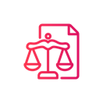



HighQ Integrations
with best-in-class solutions
Artificial Intelligence
Productivity applications
Document management
Matter updates
Project status
Document Automation
Knowledge and insight
Thomson Reuters
HighQ
Electronic signatures
Documents
Clients
Billing
information
CRM
Identity services
Other
connectors
Reporting / data visualization

Slide 25







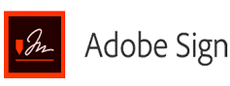



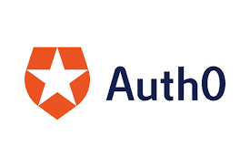



HighQ Integrations
with best-in-class solutions
AI
Productivity Applications
Document Management
Matter updates
Project status
Document Automation
Knowledge and insight
Thomson Reuters
HighQ
Electronic Signatures
Documents
Clients
Billing
information
CRM
Identity Services
Other Connectors
Reporting / data visualization

Slide 26
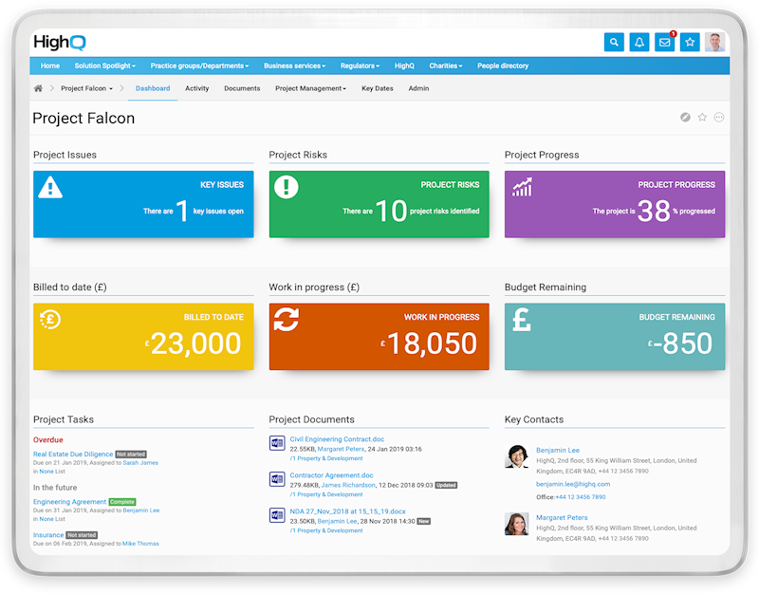
HighQ for
Law Firm
Client engagement
Dramatically improve the way you collaborate with clients and partners by giving them simple, secure access to content and projects on your network
Portfolio management
Capture, store, and search all information and files related to your portfolio, from private equity investments and real estate assets to trademarks.
Document collaboration
Improve your team’s productivity and unlock its potential by introducing a more modern and social way to collaborate and communicate
Litigation management
Provide anywhere, anytime access to the critical documents and details of a case, including disclosure, evidence, and deposition tracking plus invoice and task management
Legal project management
Plan, organize, track, and complete work more efficiently and intelligently with our agile project management and productivity tools
Compliance management
Easily track regulatory changes, manage compliance processes, and collaborate with outside parties to ensure effective risk management.
Transaction management
Add efficiency and transparency to M&A, property, and other deals with a centralized, secure place to manage all documents, tasks, and data
Team collaboration
Offer a complete digital workplace where staff can stay informed, communicate easily, collaborate on documents, and manage tasks.

Slide 27

FIRM CHALLENGES
Operations Trend
90% of respondents say client fee pressure is a risk with 37% saying it’s a high risk.
2019 Law Firm Business Leaders Report: Outlook for U.S.-Based Local and Regional Firms
Firm Operations
Practice Areas
Client Engagement
Client Engagement
Document Collaboration
Legal Project Management
Team Collaboration
Portfolio Management
Litigation Management
Compliance Management
Transaction Management
Practice Area Trend
90% of respondents say client fee pressure is a risk with 37% saying it’s a high risk.
2019 Law Firm Business Leaders Report: Outlook for U.S.-Based Local and Regional Firms
Document Collaboration
Legal Project Management
Team Collaboration
Notes:
So how do you differentiate yourself?
When we talk with our customers to seek out more ways to get to increased efficiency, we find that oftentimes firms need to support both operational and practice area concerns. But I’d like to hear about how you are addressing these areas.
---
Begin to ask questions of the prospect to assemble a use case/proof of concept conversation:
How are you managing Client Engagement now—are your customers asking for customer portals?
What is your firm currently doing for collaboration—and what I mean by that is sharing documents.. Is it email or some other file-sharing?
If they respond with basic file sharing solutions [Box, Dropbox, Sharefile, Accelion]
Ask how it’s going, and listen.
When they stop, our typical response is to mention this is not uncommon, as they are easy to implement and inexpensive; but most firms quickly outgrow them and quickly discover that collaboration needs are greater than what these tools provide. HighQ can help here, as there’s one point of entry and is branded for the firm, establishing trust—which is a better experience for the firm’s customers. And far better then a third party, generic login experience.
Additionally, HighQ easily accommodates all collaboration needs across the firm from one solution which can vary significantly between practice groups. This can include basic file sharing, client portals, deal/data rooms as well as more innovative use cases that include legal project management and workflow automation that more innovative firms are using to create that “stickiness” to client relationships. HighQ is at the heart of creating value for your clients.
Lastly, with HighQ’s security the firm retains full access and audit trails as well as control over security rights. You can control whether certain users can edit and download documents or restrict them from downloading or printing. We also support watermarks and can even allow the firm to protect and control documents that have been downloaded and are stored on a third-party computer. Our DRM (digital rights management) allows a firm to remove a user’s access to files even after the user has downloaded them to their own computer.
If they respond that they use email with attached documents to clients:
Ask how that is working out.
In most cases the IT department is frustrated because of file size limitations, blocked emails, exchange storage capacity, etc.
We should quickly point out that this is not an ideal scenario for clients because clients don’t have all of the organizational systems (DMS, case management, etc.) that law firms have.
This means that they are using MS Outlook as their case management system which is difficult at best and is often difficult for them to find the latest version of information from their firm as it gets lost in their inbox. With HighQ the firm is delivering the information to the client in a much more eloquent fashion because the information is organized and makes it easy for the client to find the latest versions of key information and documents the firm provides for them. Additionally, email is not very secure and creates some risk of liability for the firm.
If they respond that they are using MS SharePoint for client collaboration:
Ask how it is going.
In most cases the IT department is only doing this on an ad hoc basis because MS SharePoint requires a LOT of IT time to administer and set up.
Additionally, if the firm wants to do anything beyond basic functionality, they will have to invest in custom software development to make SharePoint do anything innovative or unique.
Firms are quickly moving away from SharePoint because of the high cost of software ownership and the administrative burden of managing it.
HighQ offers an out of the box solution that requires “no code” and would permit the firm to roll out sophisticated collaboration sites with very little (or no) IT time.
If they respond that they are using NetDocs or iManage fileshare (DMS):
Ask how it is going.
These tools offer only rudimentary filesharing capability and cannot offer the breadth of flexibility or innovation that HighQ offers—no workflow, automation, or other innovative use cases that add special value to clients. Just rudimentary file sharing.
Additionally, most firms need to share more information than just work product with clients. Document management systems generally only manage work product within the firm (never discovery documents, due diligence documents, court filings from the opposition, etc.).
Most importantly, from a conceptual standpoint, document management systems are designed specifically to provide a firm with internal control over its documents and drafting process. By allowing external users to have access to your document management system you are assuming that your users will not make any mistakes with respect to documents, versioning and access rights—any mistakes could potentially expose the wrong data to the wrong person.
We all know our lawyers and users make mistakes. As a result, most firms from a policy standpoint do not permit external users to have access to their DMS because they don’t want to expose themselves to this risk.
HighQ is much more secure because it is a separate secure location outside of the firm’s firewall in which the firm specifically selects files and other information that it wants to share with the client on HighQ. It is not opening up the firm’s internal firewall or network to external users.
Most MLF firms would not be able to duplicate HighQ’s security internally with 24x7 monitoring, best in class security features and significantly hardened infrastructure that meets today’s compliance and security standards and reduces the firm’s risk.
What is your firms approach to Legal Project Management?
Make note of their answer, if it’s spread
Are your teams collaborating effectively? What’s your solution for that?
PRACTICE AREAS
From my research, I know that your firm has developed a strong base on [insert as many practice areas as apply].
Are you managing multiple solutions to support these practice areas?

